Slide 1
2023
YEAR-END
REPORT
National Affordability and Competitiveness Task Force
Executive Summary
MARCH 2024
Notes:
This report highlights the success of the National Affordability and Competitiveness Task Force and its regional counterparts in 2023.
All cost savings are current as of March 2024.

Slide 2
EXECUTIVE SUMMARY
BACKGROUND
The National Affordability and Competitiveness Task Force was formed as part of the 2021 Alliance National Agreement to bring together labor and management to explore issues of affordability, market position, and competition affecting the future of KP in each of its markets.
In addition to the national task force, there are 7 regional task forces in Colorado, Georgia, Hawaii, the Mid-Atlantic States, Northwest, Southern California, and Washington.
MARKET OUTCOMES
Each regional task force surpassed its individual cost-savings target, reflecting the collaboration between labor and management to identify and address unique challenges in each market, such as:
Seizing opportunities to convert to Amjevita™, a significantly less expensive biosimilar with the same safety and efficacy for treating inflammatory disease as Humira®; and to reduce out-of-network COVID-19 testing
Improving affordability by making gains in quality care
  Mid-Atlantic States helping patients avoid unnecessary hospital stays and emergency room visits by using patient care coordinators to direct patients to effective care options
  In the Northwest, frontline workers are helping to save more than $1 million by coordinating the return of KP patients receiving emergency care in non-KP facilities.
  Unit-based teams projects in affordability, attendance, quality, safety, and service yielded more than $41 million
  in cost savings overall for 2023.
SUMMARY
In 2023, the goal was to achieve $76.5 million in total cost savings across 7 markets through:
Regional task forces launching mutually approved affordability projects to meet or exceed affordability targets
National task force working with regional groups to assess progress of affordability initiatives, identify and surmount challenges, develop best practices
Collectively, the National Task Force, 7 Regional Task Forces and 56,000 Alliance-represented workers achieved $114.38 million in recurring cost savings in 2023, exceeding the target by 49%.

Slide 3
OUR STORY: 2023 NACTF Members & Executive Sponsors
ALLIANCE OF HEALTH CARE UNIONS
Jonathon Baker, vice president, OFNHP Local 5017
Micheal Barnett, president, USW Local 7600
Nate Bernstein, healthcare director, UFCW Local 7
Sandra Flores, chief of staff, Alliance of Health Care Unions
Charmaine Morales, president, UNAC/UHCP
KAISER PERMANENTE
Camille Applin-Jones, vice president, Ambulatory Care and Clinical Services, Northwest
CJ Bhalla, senior vice president and chief financial officer, Northern California
Sylvia Everroad, chief operating officer (retired), Southern California Permanente Medical Group
Leslie McKendrick, senior vice president and chief operating officer, Southern California and Hawaii
Jack Weberski, vice president (Economics), National Labor Relations
TRI-CHAIRS
Jim Pruitt, vice president of Labor Relations, The Permanente Federation
Hal Ruddick, executive director, Alliance of Health Care Unions
Steve Shields, senior vice president, National Labor Relations & Office of Labor Management Partnership
EXECUTIVE SPONSORS
Chris Grant, chief operating officer, Permanente Federation
Arlene Peasnall, senior vice president, Human Resources, Kaiser Permanente
Hal Ruddick, executive director, Alliance of Health Care Unions
Notes:
Alliance of Health Care Unions:
Jonathon Baker, vice president, OFNHP Local 5017
Micheal Barnett, president, USW Local 7600
Nate Bernstein, healthcare director, UFCW Local 7
Sandra Flores, chief of staff, Alliance of Health Care Unions
Charmaine Morales, president, UNAC/UHCP
Kaiser Permanente:
Camille Applin-Jones, vice president, Ambulatory Care and Clinical Services, Northwest
CJ Bhalla, senior vice president and chief financial officer, Northern California
Sylvia Everroad, chief operating officer (retired), Southern California Permanente Medical Group
Leslie McKendrick, senior vice president and chief operating officer, Southern California and Hawaii
Jack Weberski, vice president (Economics), National Labor Relations
Tri-Chairs:
Jim Pruitt, vice president of Labor Relations, The Permanente Federation
Hal Ruddick, executive director, Alliance of Health Care Unions
Steve Shields, senior vice president, National Labor Relations & Office of Labor Management Partnership
Executive Sponsors:
Chris Grant, chief operating officer, Permanente Federation
Arlene Peasnall, senior vice president, Human Resources, Kaiser Permanente
Hal Ruddick, executive director, Alliance of Health Care Unions

Slide 4
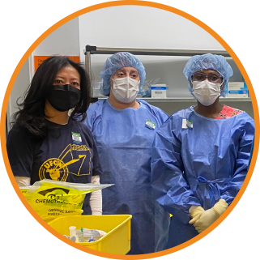
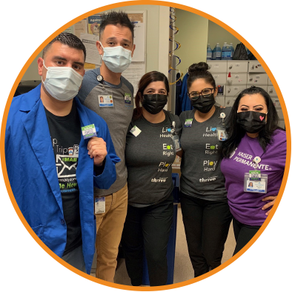

OUR STORY: A Timeline
2023
Regional task forces launch mutually approved affordability projects
National task force works with regional groups to assess progress of affordability initiatives, identify and surmount challenges, develop best practices
Regional task forces meet and exceed affordability targets
2021
Alliance National Agreement
establishes the National Affordability
and Competitiveness Task Force
2022
National task force convenes with 10 representatives from Kaiser Permanente
and Alliance of Health Care Unions
Task force members focus on governing structure and forming regional task forces
Regional task forces launch in Colorado, Georgia, Hawaii, Mid-Atlantic States, Northwest, Southern California and Washington

Slide 5
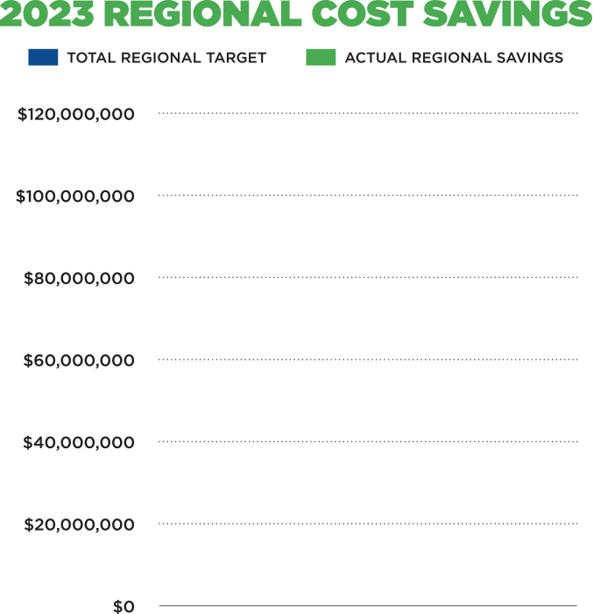
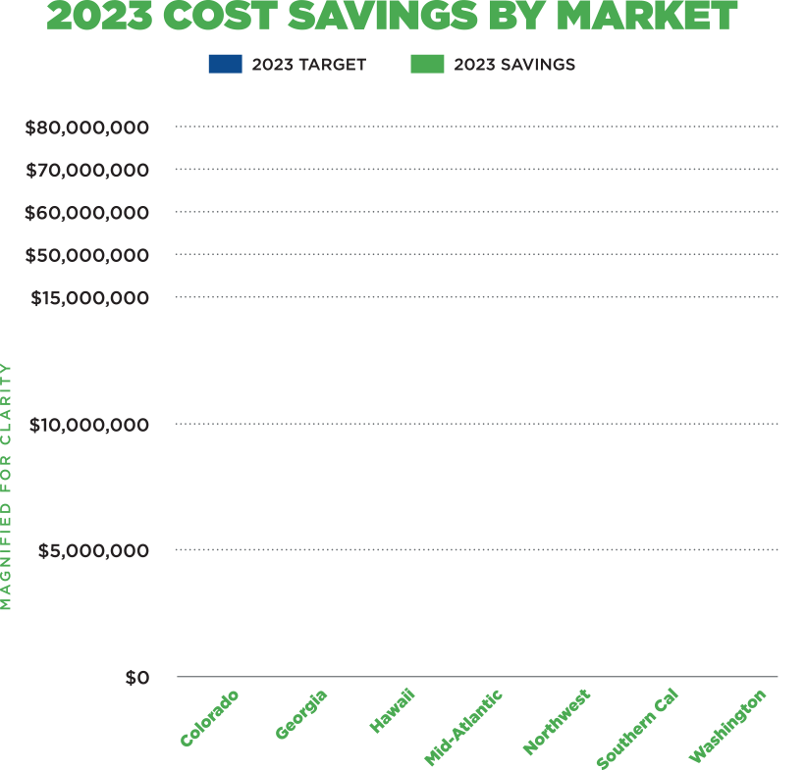
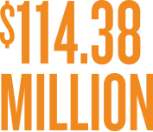

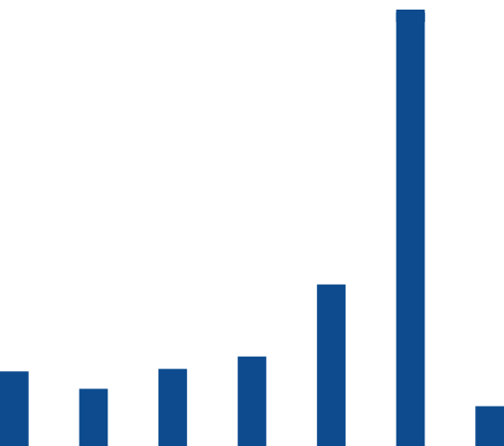

OUR MARKETS: By the Numbers
Notes:
Each regional task force surpassed its individual cost-savings target, thanks to labor and management working together to identify and address unique challenges in each market.
Collectively, we achieved more than $114 million in recurring cost savings in 2023 – 49% above target for the year!
Next we will review the success that was achieved in each market

Slide 6


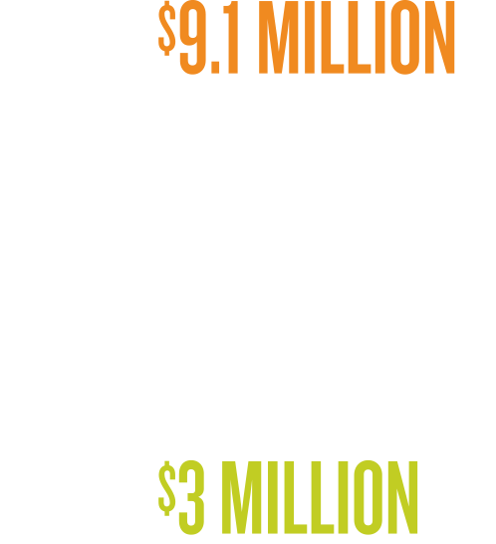
COLORADO
PROJECT SPOTLIGHT
Revised approach to treatment of eating
disorders. Developed assessment tool to
better link patients – mostly children – to
appropriate therapy. Improved patient
outcomes while reducing out-of-network
referrals, saving $405K.
Notes:
Colorado achieved $9.1 million in savings – more than 3 times its 2023 target.
Unit-based teams played a big role in the region’s success, contributing $8.6 million in savings from projects focused on quality, service, safety, and affordability.
One highlight:
The regional Behavioral Health Eating Disorder team developed a new assessment tool that enabled it to more effectively treat patients diagnosed with a catch-all eating disorder known as ARFID (Avoidant/restrictive food intake disorder). As a result, a large number of these patients - many of them children – are being treated in-house rather than being referred to out-of-network specialists. The decrease in outside referrals and treatment led to $405,000 in savings – and more effective care for our members and patients.

Slide 7
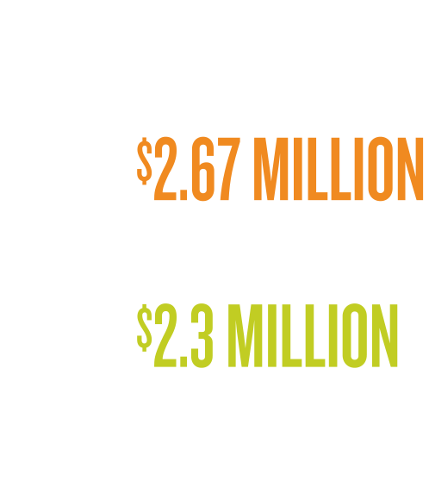
GEORGIA
PROJECT SPOTLIGHT
Captured lost revenue through enhanced
staff training and use of automated
check-in kiosks that increased collections
of outstanding balances and copays,
saving $2.28M.
Notes:
Georgia achieved $2.67 million cost savings in 2023 – 16% above target.
One highlight:
A successful project that reduced costs by $2.28 million through improved collections of outstanding member balances and copays. Front office staff in medical office buildings received additional training to ensure they were inquiring about outstanding balances and copays. These facilities also increased the use of automated check-in kiosks that require payment of outstanding balances before the check-in process is completed.

Slide 8
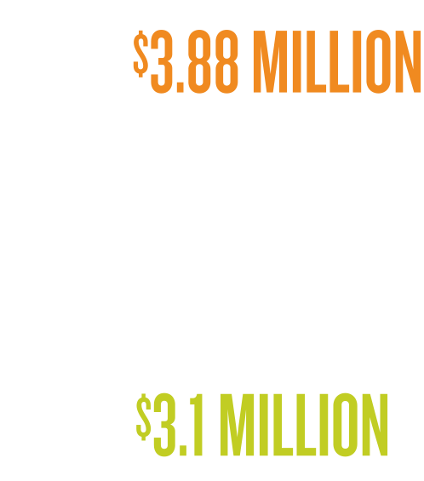
HAWAI’I
PROJECT SPOTLIGHT
Moanalua ICU/CVICU team reduced
catheter-induced urinary tract infections
by more than 73%. Their success was
part of a market-wide effort to reduce
healthcare-associated infections that
saved nearly $1M.
Notes:
Hawaii achieved $3.88 million in cost savings – 25% above target.
Examples of noteworthy UBT projects include:
The ICU and Cardiovascular ICU team at Moanalua Medical Center, which reduced catheter-induced urinary tract infections by more than 73%. Their success helped reduce healthcare-associated infections throughout the Hawaii market and save nearly $1 million.

Slide 9
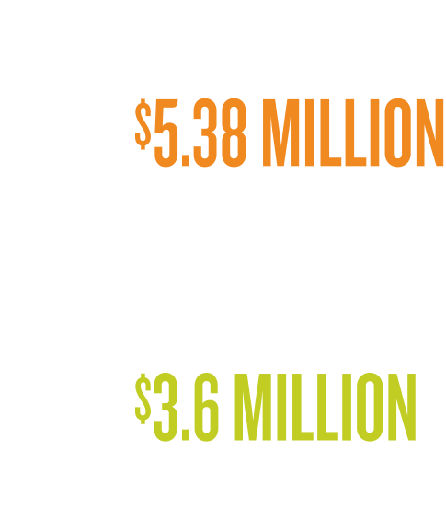
MID-ATLANTIC STATES
PROJECT SPOTLIGHT
Continuum of Care Initiative embedded
patient care coordinators in urgent care units
to connect members with appropriate care.
Effort reduced referrals to hospitals and
emergency rooms, saving $3.1M.
Notes:
Mid-Atlantic achieved $5.38 million in savings – 49% above target.
The biggest cost savings comes from the region’s Continuum of Care initiative, which embeds patient care coordinators in urgent care and advanced urgent care units to help reduce unnecessary hospitalizations and emergency room visits.
Begun in June 2023 as a pilot, the program has reduced the ‘Average Daily Transfer Rate’ from urgent care units to hospitals. Overall, the project saved $3.1 million in 2023.

Slide 10
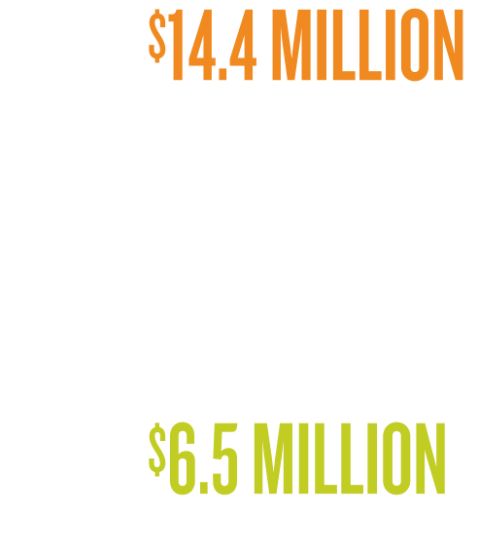
NORTHWEST
PROJECT SPOTLIGHT
The Regional Telephonic Medicine Center
team expanded efforts to return patients to KP when they receive emergency care in
non-KP facilities, saving $1.1M.
Notes:
The Northwest achieved $14.4 million in savings in 2023 – 122% above target.
Highlights included some fruitful projects by unit-based teams, including:
The Regional Telephonic Medicine Center team, which expanded efforts to return patients to KP when they receive emergency care in non-KP facilities. These efforts resulted in $1.1 million in savings in 2023.

Slide 11
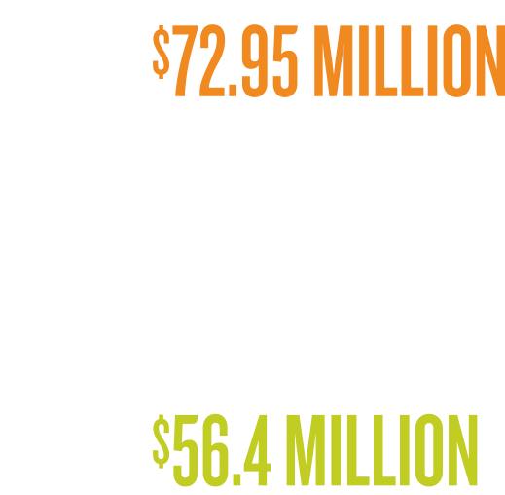
SOUTHERN CALIFORNIA
PROJECT SPOTLIGHT
Alliance union members took part in more
than 800 UBT affordability projects that
contributed to savings totaling $23.8M in
Southern California. Projects touched
on affordability, attendance, quality,
safety, and service.
Notes:
Southern California achieved $72.95 million in savings – 29% above target.
Southern California’s achievement included nearly $24 million in savings through more than 800 individual unit-based team projects involving Alliance union members. Projects focused on improving affordability, attendance, quality, safety, and service.

Slide 12
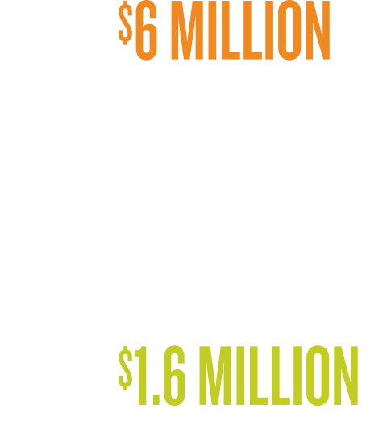
WASHINGTON
PROJECT SPOTLIGHT
Converting to Amjevita™, a less expensive
biosimilar with same safety and efficacy
as widely used anti-inflammatory drug
Humira®. Regional task forces helped
push conversion rate above 90% in
several markets, saving $6 million
in Washington.
Notes:
The Washington region achieved $6 million in savings in 2023 – 21% above target.
Most of this savings came from converting to Amjevita™, a biosimilar that is significantly less expensive than Humira®, with the same safety and efficacy for treating inflammatory disease.
Biosimilars are competitors to complex biologic drugs like Humira that are made inside living cells. KP has overseen several biosimilar conversions over the past decade.
While KP set a 80%“conversion rate” for Amjevita™ in 2023, efforts by regional task forces have helped push that rate above 90% in markets.
In Washington, this effort saved $6 million in 2023.

Slide 13
2023
YEAR-END
REPORT
National Affordability and Competitiveness Task Force
Executive Summary
MARCH 2024

