Slide 1
INSPIRE CHANGE: Create your UBT Fair storyboard
Notes:
NOTE TO PRESENTER:
This slide deck is intended to help teams design and construct their own storyboards for the unit-based team fair.

Slide 2
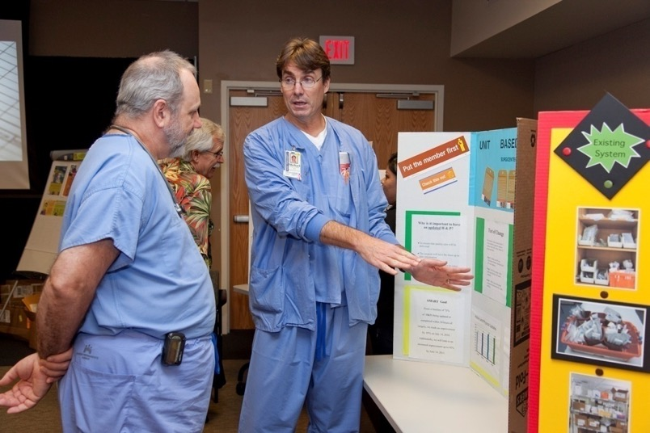
What is a storyboard?
Promote your team
Spread successful practices
Practice public speaking
Notes:
2
NOTE TO PRESENTER:
Ask the question: What is a storyboard?
Suggested definition: a stand-alone summary of team’s work that allows for discussion with some visual help
Make the storyboard visually appealing
Remember it’s primarily image-driven
Keep writing simple and brief

Slide 3
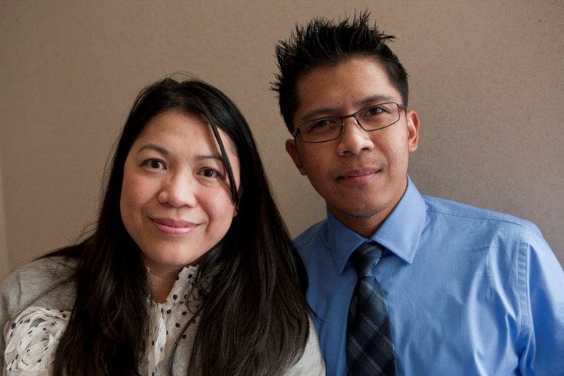
Who’s your audience?
People in your unit
People in related units
People in your medical center
Notes:
3
NOTE TO PRESENTER:
Discuss the main audiences as a way to help teams decide what the content will be.
People in your unit
They will view under almost any circumstances
Goal: morale and team builder, opportunity to reflect on joint efforts
People in related units
They can be easily persuaded to view
Goal: spread best/effective practices among similar teams in facility, service area or region
Other people in your medical center
They can be attracted and engaged by a good presentation
Goal: Helps bring reward and recognition to the teams
Special guests
Other audiences who might be present include special guests from the region, program office, LMP, etc.

Slide 4
Tell your team’s story
Inspire Change Storytelling Template
Notes:
NOTE TO PRESENTER:
Use the LMP Inspire Change Story template to get started
Handout storybooks or extra template slides Make the following suggestions to the teams who are preparing content for the storyboard:
Avoid long sentences and paragraphs
Put related text and images near one another
Results as figures (tables if necessary) Make sure your storyboard contains these elements:
Give reason why you chose project (the foundation for your work: regional and local objective, use SMART Goal, AIM statement)
Describe how you did the project (flow charts, RIM and PDSA cycle, run charts, etc) Go beyond just raw data
keep numbers simple
show how test of changes worked out
connect to real world problem
4

Slide 5
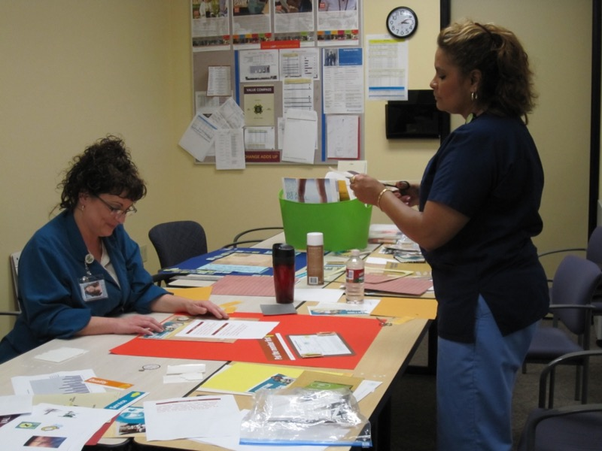
Gather your materials
Tri-fold display boards
Scissors
Glue sticks and tape
Construction paper
Hanks, Bulletin Board posters
Team and project photos
Copies of charts and graphs
Notes:
5
NOTE TO PRESENTER:
Help teams block out time in their UBT team meetings or co-lead trainings to brainstorm and work on storyboards as a team.

Slide 6
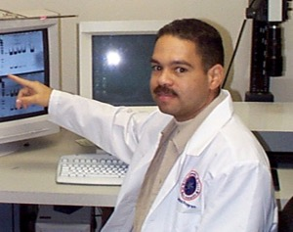
Prepare your artwork
Use standard formats:
.jpg, .gif, .tiff
Select photo resolution:
300 dpi or higher
DON’T stretch photos
Notes:
6
NOTE TO PRESENTER:
Use this slide to emphasize how to prepare photos for the storyboards
Also refer to the UBT Fair in a Box design presentation
Image file formats are standardized means of organizing and storing digital images. The PNG, JPEG, and GIF formats are most often used to display digital photos. Nearly every digital camera can save images in the JPEG. Some digital cameras can save in TIFF format, which is widely used in the printing business.

Slide 7
Put together your storyboard
Notes:
7
NOTE TO PRESENTER:
(Refer to design presentation for more advanced ideas) Consider making rules or criteria for your storyboards
Board size: use standard trifold size, requirement/maximum
Metrics, charts or numbers
Contact Information
Section headings: label each section
Font size: range from 20 to 72 font or larger, Larger fonts for titles (1-2” high), Use at least 20 pt font for body text (should be able to read from 3-feet away); Numbers must also be large enough
Can make contact info, references, acknowledgements smaller
White space: create enough to make text readable
Neutral backgrounds: consider so background will not compete with other content
Balance text and images
Avoid “all caps”

Slide 8
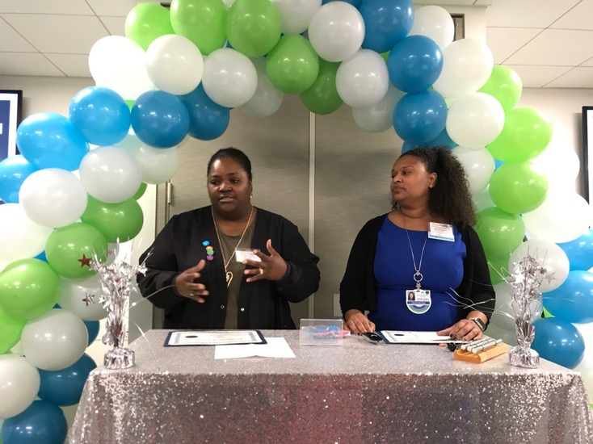
Talk about your storyboard
Prepare a brief talk about your storyboard
Figure out what to say for each image or chart
Keep display clutter, images and sound to a minimum
Practice with a co-worker, friend, relative — or favorite stuffed animal
Notes:
8
NOTE TO PRESENTER:
Storyboards can’t talk. Prepare your script for how you will describe your work at the UBT fair.
Other advice to provide:
Do not stand directly in front of storyboard
Make eye contact and smile
Give name and job title
Ask whether viewer familiar with UBTs
No? More introduction, avoid acronyms
Yes? Move into presentation

Slide 9
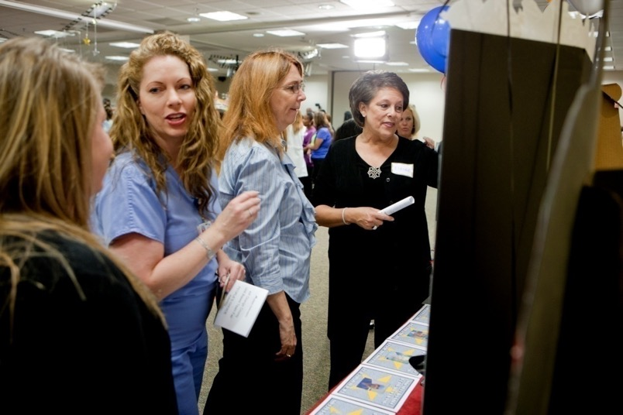
On the day of your UBT fair
Wear business casual or work attire
Wear comfortable shoes
Arrive early
Bring business cards or team newsletters and posters
Bring water bottle, mints
Take turns presenting with team members
Notes:
9
NOTE TO PRESENTER:
Here are some tips for showcasing your storyboard at the UBT fair:
Don’t memorize; learn your material
Be excited about your work, speak from the heart
Remember to refer to your storyboard
Be prepared to answer questions
Give extra information if asked

Slide 10
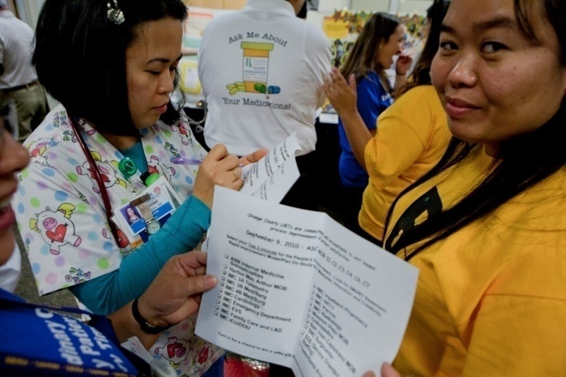
After your UBT fair
Network: write down ideas and names
Send emails to people you’ve met; thank them
Display your storyboard at your lab, workstation, break area if there is room
Notes:
10
NOTE TO PRESENTER:
Encourage a debrief and action steps for participating teams
A few suggested ideas:
Post a photo of your storyboard on IdeaBook or send photos to your facility communicator
Send an email to your unit with photos from your UBT fair
Write about the fair in your UBT newsletter

